Slide 1
Overview
Notes:
Warrior Creed

Slide 2

Leading Your First Team
How To Prepare Yourself To Lead Your First Team
Notes:
IronHED Media presents…
What it takes to lead your first team
This is a course about developing a leader then leading a team
The ideas presented here are based on an aggregation of information derived from multiple proven leadership models.
The foundational model presented here aggregates Military Football and Business ethos.
Roots of the Leadership framework.
Warrior Creed – Navy Seals
Gogins – David Goggins
Lombardi – Vince Lombardi
Carnegie – Dale Caregie
IronHED – Peter McQuillan
I will be presenting ideas and concepts referencing my personal experience and what I learned from Lombardi the Football coach, Caregie the Business Coach, Goggins the retired Navy Seal and the Warrior Creed.

Slide 3

Leaders Are Made Not Born
Leadership grows out of self-knowledge, character, integrity, competence and a comprehensive vision

Slide 4

Leaders know better
Your personal leadership ethos defines your character, standards and guiding beliefs.
Notes:
Its about standards
Guiding Beliefs

Slide 5
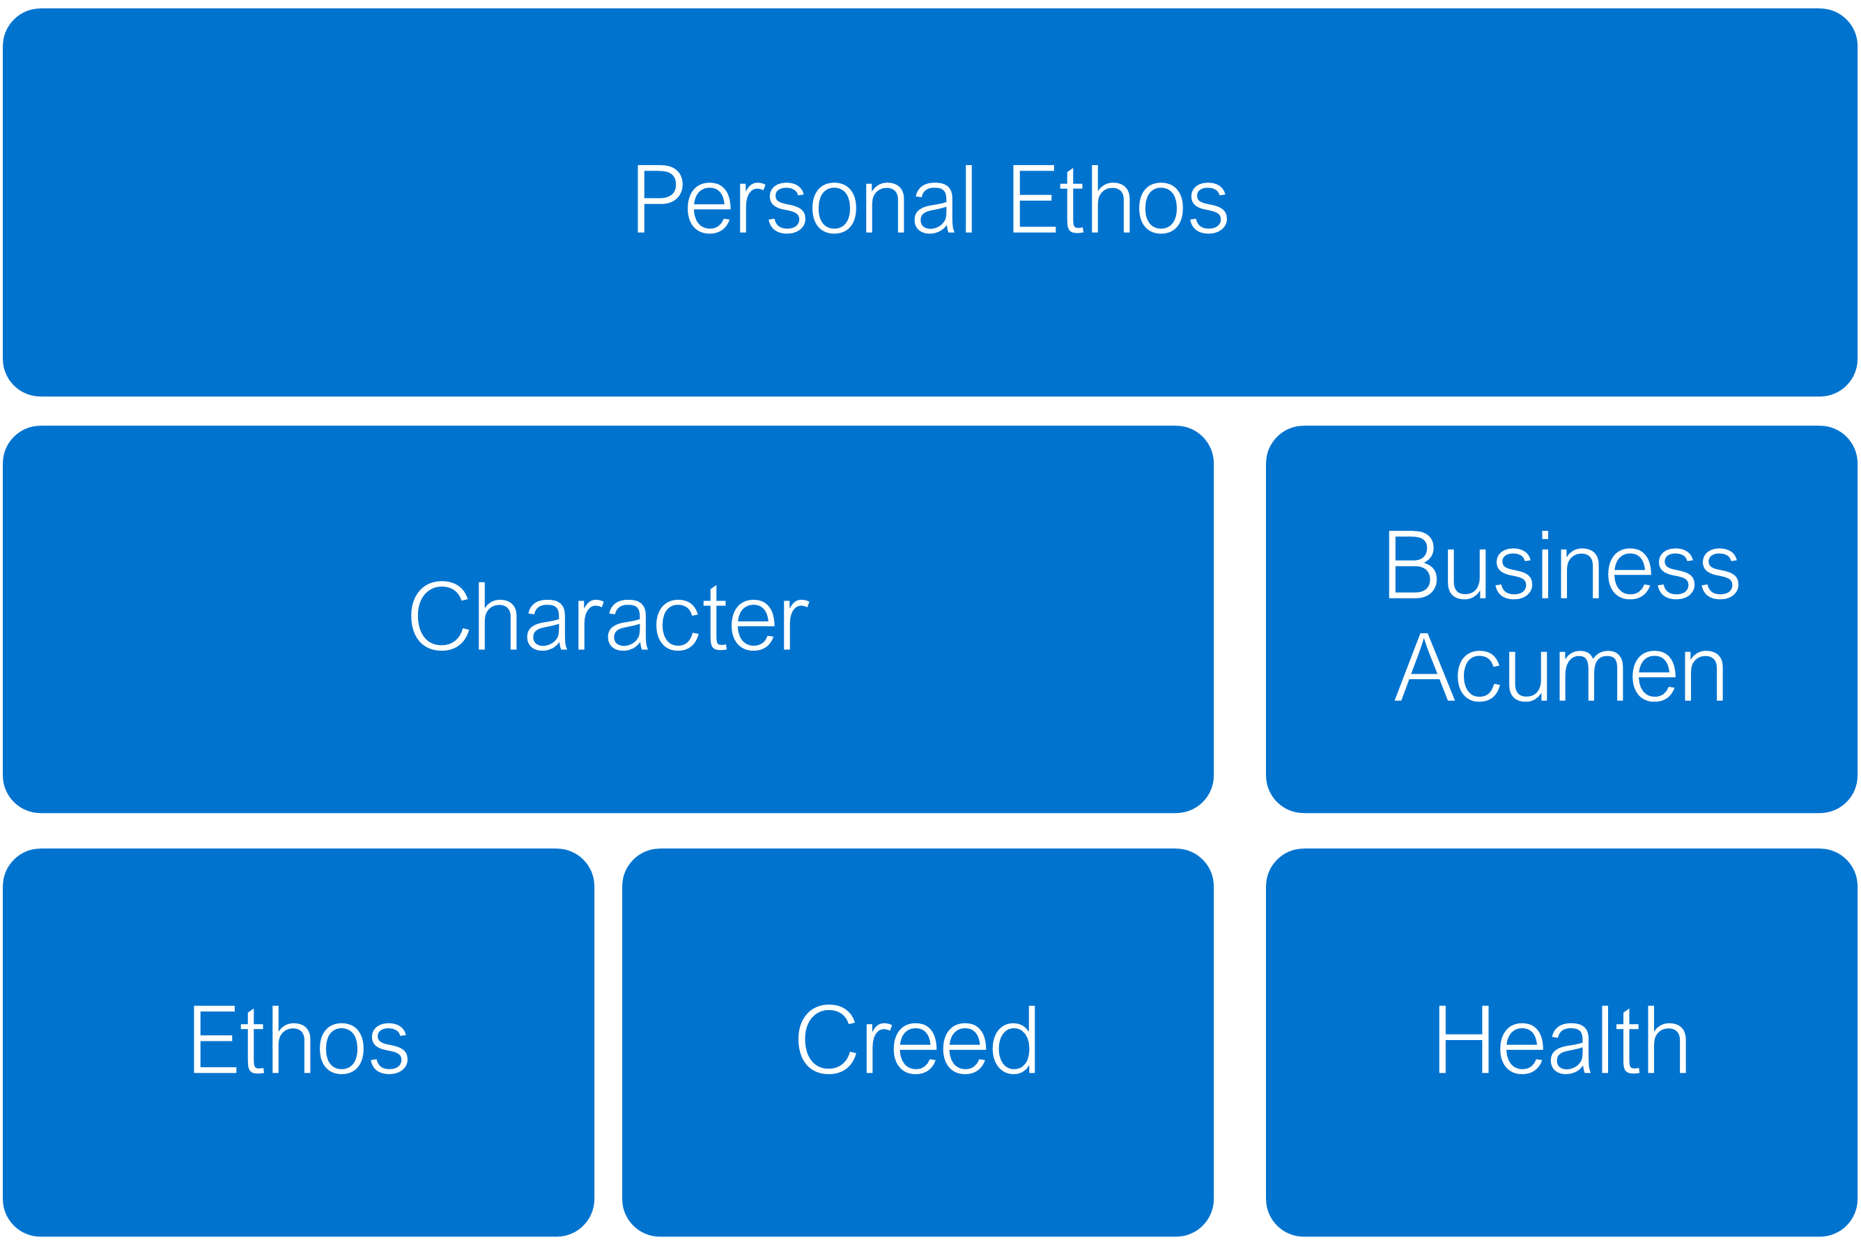
What It Takes to Lead Your First Team
Part 2 - How to Lead Others
Everything you do and don’t do reflects on your leadership
Part 1 Building your Personal Ethos… The first step to Leadership
Notes:
Build your leadership skills
The use those new found skills to lead a team.

Slide 6
Leadership Ethos
It is Your Leadership Ethos that best describes who You and Your Team are
Notes:
Lombardi
What do you stand for…from a business perspective.
How are you known?

Slide 7
Personal Ethos
Character
Ethos
Creed
Business Acumen
Health

Slide 8
End Overview
Notes:
Warrior Creed

